Slide 1

Power BI
Project
On Adidas Sales Analysis
Syed Nadeem Yousuf

Slide 2
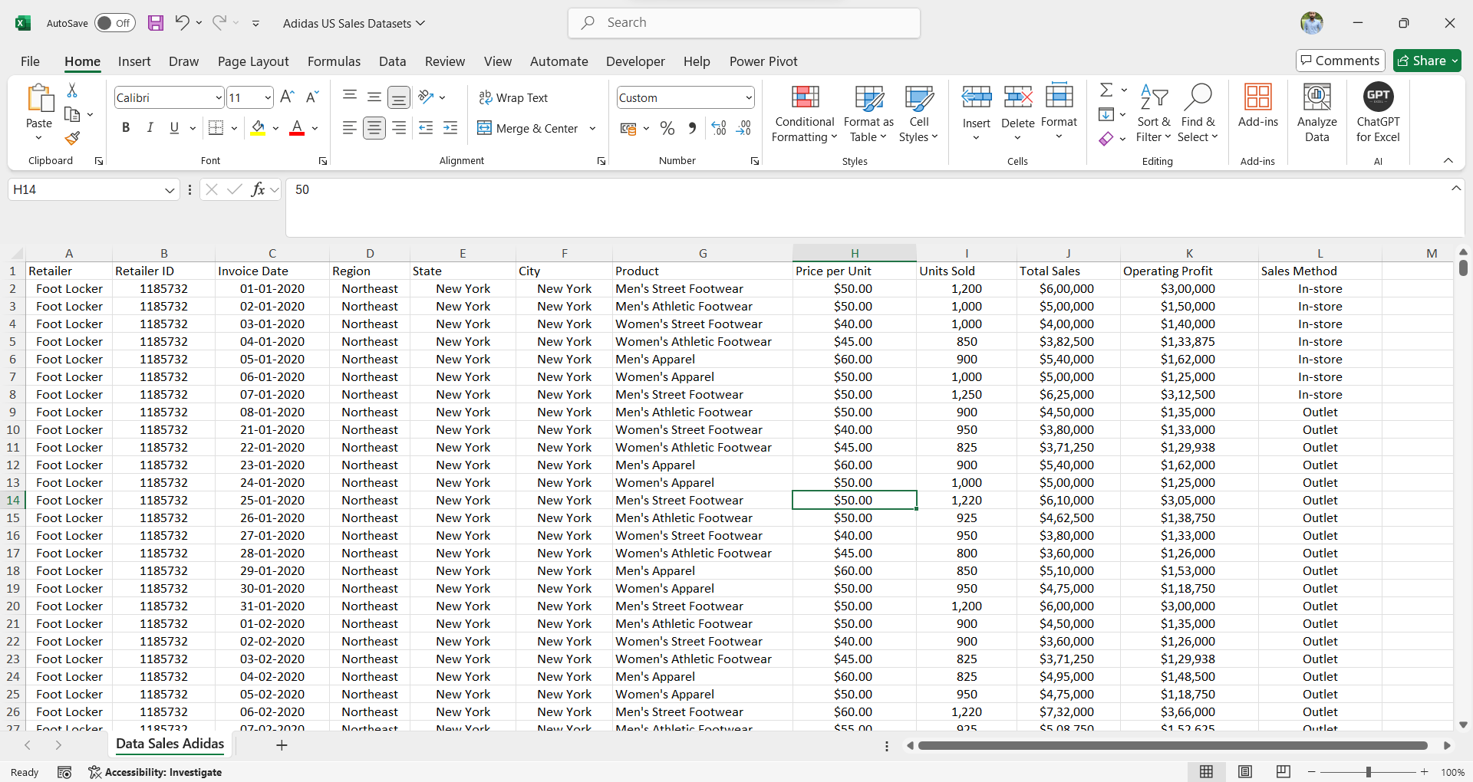
From this raw data

Slide 3
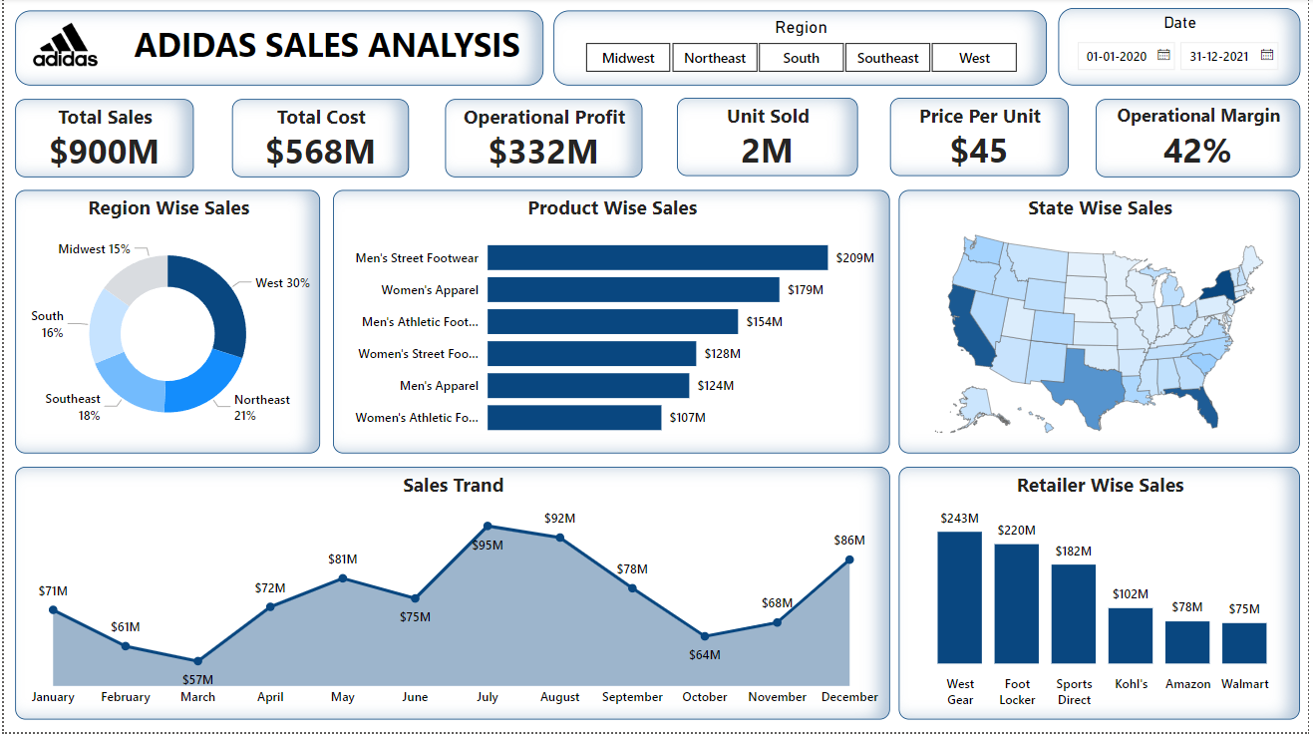
To this amazing dashboard

Slide 4
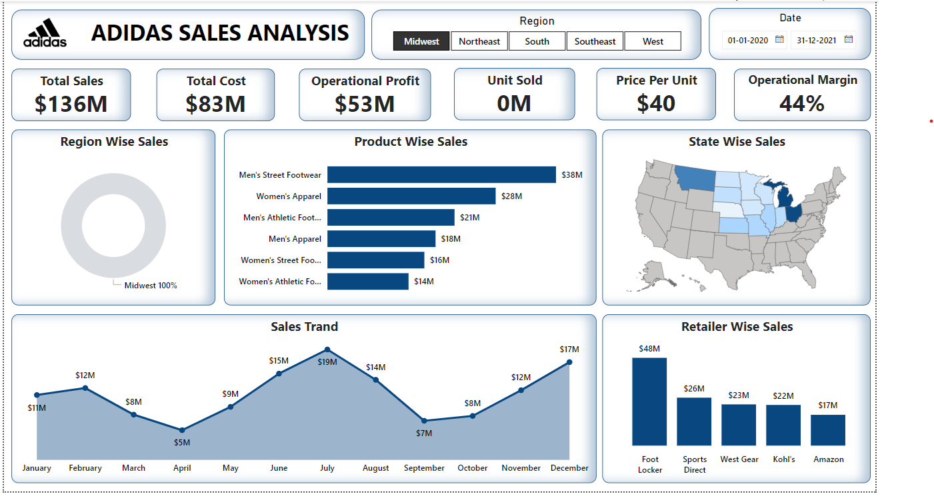
Midwest Region (Slicer)

Slide 5
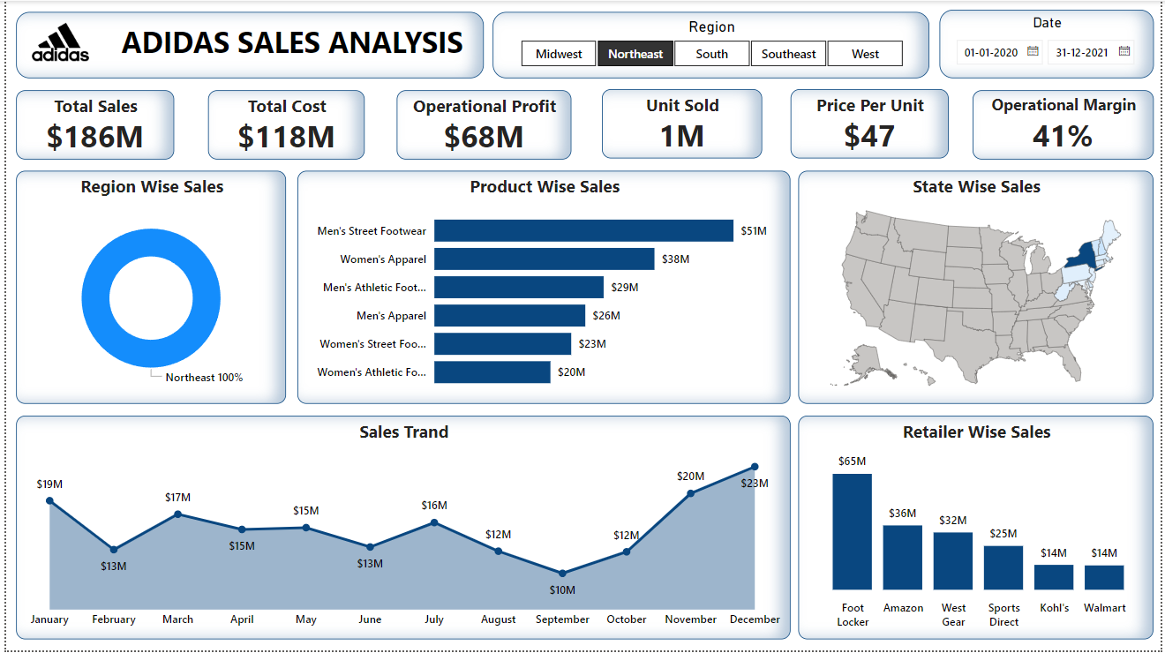
Northeast Region (Slicer)

Slide 6
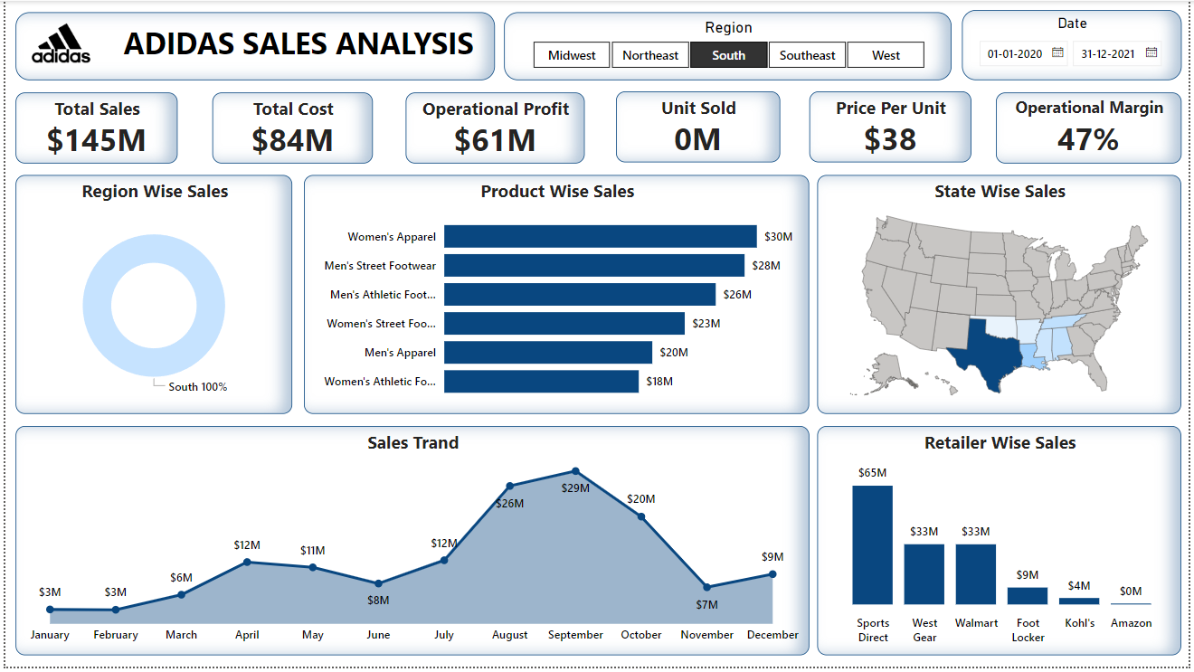
South Region (Slicer)

Slide 7
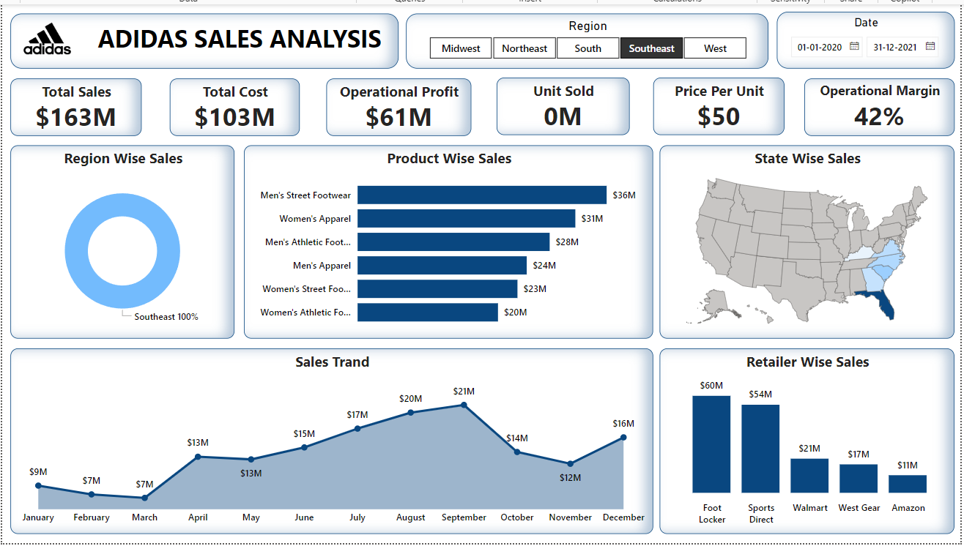
Southeast Region (Slicer)

Slide 8
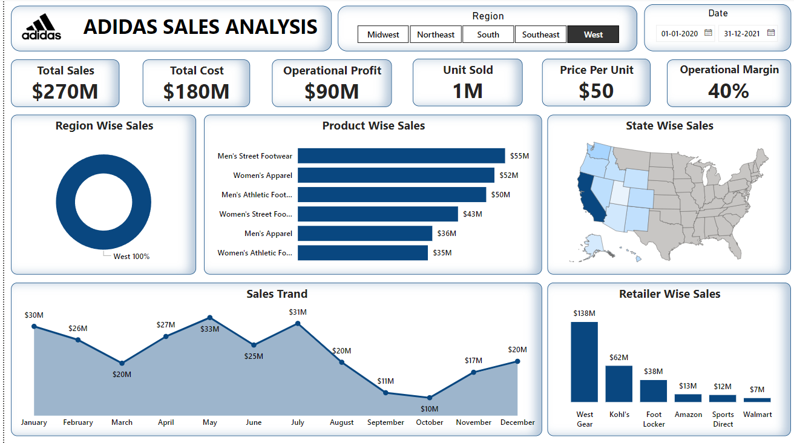
West Region (Slicer)

Slide 9
Explaining these KPI’s
Total sales of Adidas is $900 million, with $568 million in production costs. From these sales, a total operational profit of $332 million was generated, with 2 million units sold at an average price of $45 per unit. The average operational profit margin stands at 42%.

Slide 10
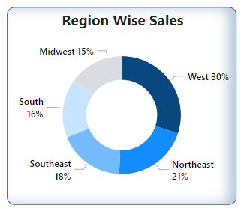
Explaining each chart which are used in this project
Donut chart
This Donut chart highlights regional performance, with the West region leading with 30% of total sales. This indicates that the West is Adidas’ strongest market, making it a focus area for future growth.

Slide 11
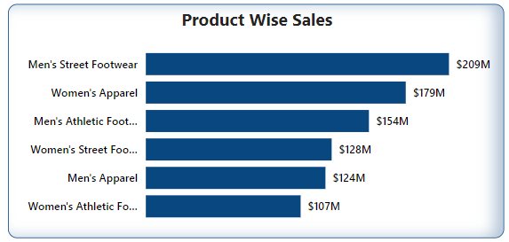
Bar chart
Looking at product performance, the bar chart shows that the best-selling product is Men's Street Footwear, while the least sold product is Women's Athletic Footwear. So special attention is needed on Women's Athletic Footwear.

Slide 12
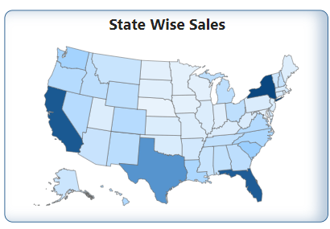
Shape Map
The shape map chart uses color shading to represent sales intensity. The darker the shade, the higher the sales. New York stands out with the highest sales, followed by California, Texas, and Florida. These states represent major hubs for Adidas sales, driven by both population and consumer interest.
New York
California
Florida
Texas

Slide 13
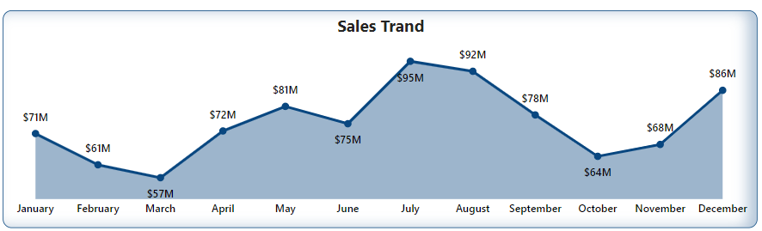
Area Chart
The area chart reveals that the highest sales occurred in July, August, and December, likely due to peak shopping periods like summer sales and the holiday season. In contrast, the lowest sales were in February and March, perhaps indicating a seasonal dip in consumer spending.

Slide 14
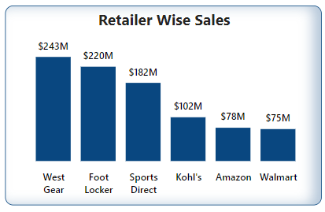
Column Chart
Finally, the column chart shows the performance of various retailers. West Gear recorded the highest sales, while Amazon and Walmart had the lowest sales. This insight could guide Adidas to reconsider its distribution strategy across different retail partners.

Slide 15
Thank You

